Slide 1
Data Modeling

Slide 2
ER Modeling

Slide 3
Entity Relationship Modeling
Allows you to model the real world as entities and relationships
Graphical notation is easy to understand, allowing technical architects to convey complex designs to others
Can be used to model databases table structure

Slide 4
Entity Relationship Modeling
Entities
The object which is holding the data
Are often recognizable objects like persons, places, events or concepts
Patient
Employee
Company
Project
Each Entity is analogous to a table in a database

Slide 5
Entity Relationship Modeling
Entities may be independent or dependent
Independent entities do not rely on other entities for identification
Dependent entities rely on other entities for identification

Slide 6
Entity Relationship Modeling
Relationships
Relationships may exist between entities
Project Managers have projects
Car dealerships have cars
Facebook Friends have other friends
Observations belong to Encounters

Slide 7
Connectivity
One-to-One (1:1) One instance of a particular entity is associated to exactly one instance of another entity
Example: Each unique instance of a student is given a unique instance of a chair. There is no sharing of chairs

Slide 8
Connectivity
One-to-many (1:n) An instance of a particular entity is assigned 0, 1, or many instances of another entity. Each of the other entities only belongs to one entity.
One album has many songs in it, however, each song belongs to exactly one album

Slide 9
Connectivity
Many-to-Many (m:n) An instance of entity A is assigned 0, 1, or many instances of entity B. Entity B is assigned 0,1 or, many instances of entity A.
Employees are assigned multiple projects. Each project has many employees

Slide 10
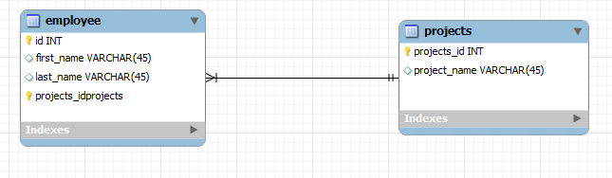
Entity Relationship Modeling
A diagram modeling a one-to-many relationship between projects and employees

Slide 11
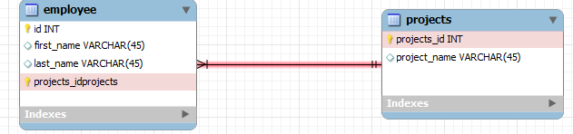
Entity Relationship Modeling

Slide 12
Entity Relationship Modeling
But wait a second, employees could be on more than one project couldn't they?
Yes…let's change our diagram and make it reflect the many-to-many relationship

Slide 13
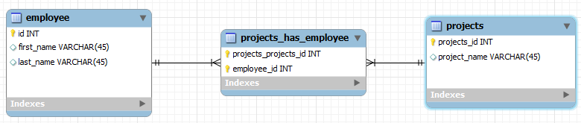
Entity Relationship Modeling
Employees are on many projects
Projects have many employees

Slide 14
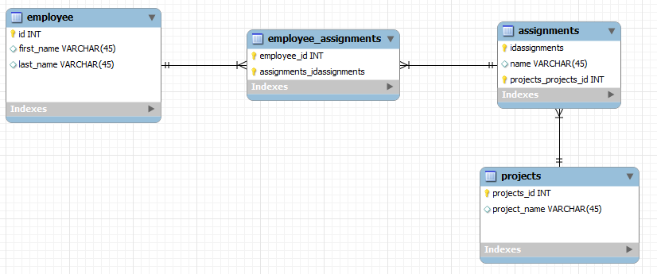
Entity Relationship Modeling
Let's give employees assignments to work on. Projects consist of many assignments

Slide 15
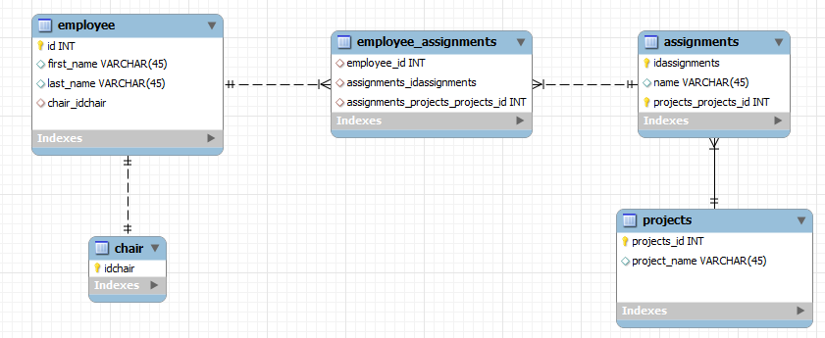
Entity Relationship Modeling
Let's give each employee a chair

Slide 16
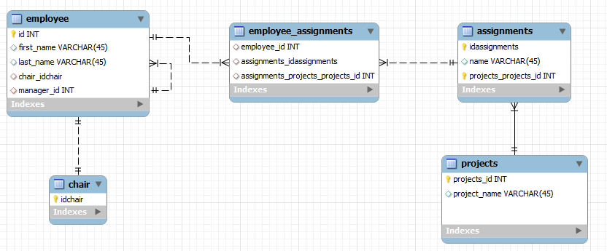
Entity Relationship Modeling
Let's add a manager. Each manager has multiple employees. This is a recursive relationship

Slide 17
Get the Design Tool
\\intare\Public\Software\Database

